Slide 1


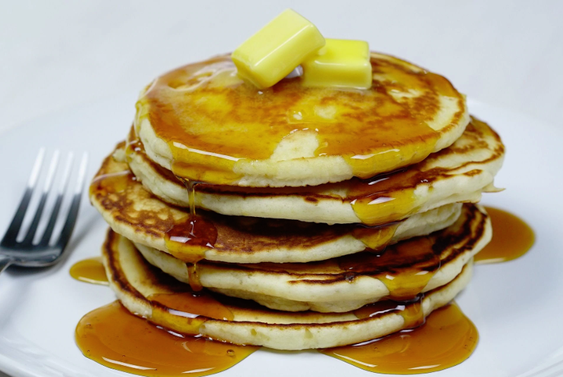


AHEPA 3rd Annual BLOOD DRIVE
At KIMISIS TIS THEOTOKOU
Saturday March 2, 2019
8:00 AM to 1:00 PM
DELICIOUS pancake breakfast for all donors!
Sign up at Kimisis Tis Theotokou Sunday coffee hour, or at www.redcrossblood.org ‘donate blood’, or email Paul Gilbride at PFG3333@yahoo.com
Your blood donation will help save lives!!

